Slide 1


Sra. Cafara
acafara@jacksonsd.org

Slide 2



My name is Sra. Cafara. I’ve been a teacher at JMHS for the past 16 years. I’ve taught courses Spanish 1 thru now AP Spanish Lang. I have three wonderful children ages 10, 8, and 7. I love teaching and inspiring my students to learn languages. I also speak heritage Italian from my parents and I’m learning French!

Slide 3
Class Expectations
Students will be required to listen, speak, read and write within their level of linguistic ability.
All upcoming tests/quizzes and homework are available on the the Genesis Portal.
Google Classroom will be used for projects/ announcements, etc.
Students also have access to Quizlet (vocab flashcards/games/review) I have study sets for every concept and chapter. All sets are shared on Google Classroom for the students to study.
Duolingo (free app to reinforce the language.) is also used to assist with practice at home.

Slide 4
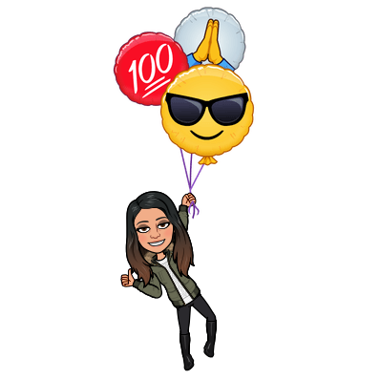
EVALUATION
Tests/Quizzes/Projects 50%
Class Participation 30%
Homework 20%
100%
Notes:
‹#›

Slide 5


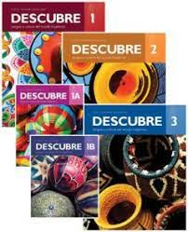

Textbooks
www.vhlcentral.com
Students have their usernames and passwords.
Students have not received a textbook. Students are able to see everything in the book online.
Please let me know if you would like your child to have a hard copy.

Slide 6
PUPIL EXPECTATIONS
Students are expected to arrive to class on time.
Students are given homework weekly. Most homework is to use Google Classroom to write down notes. This is to allow more class time for practice.
The main focus of in person class time is instruction and practice, especially speaking practice.

Slide 7
Participation
Students’ participation grade is mainly based on attentiveness and use of Spanish in class each day. Each day students are responsible for questions/practice. These gets added to their biweekly participation grade. The rubric is available on my JMHS Teacher page under student resources.

Slide 8
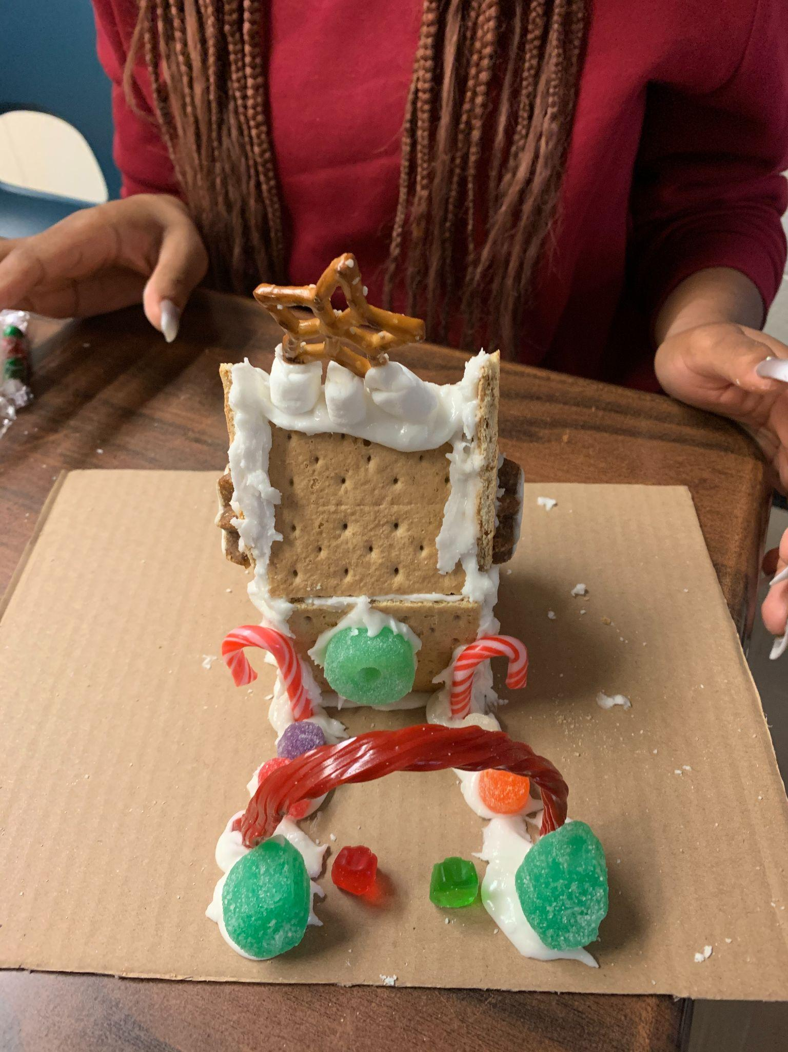
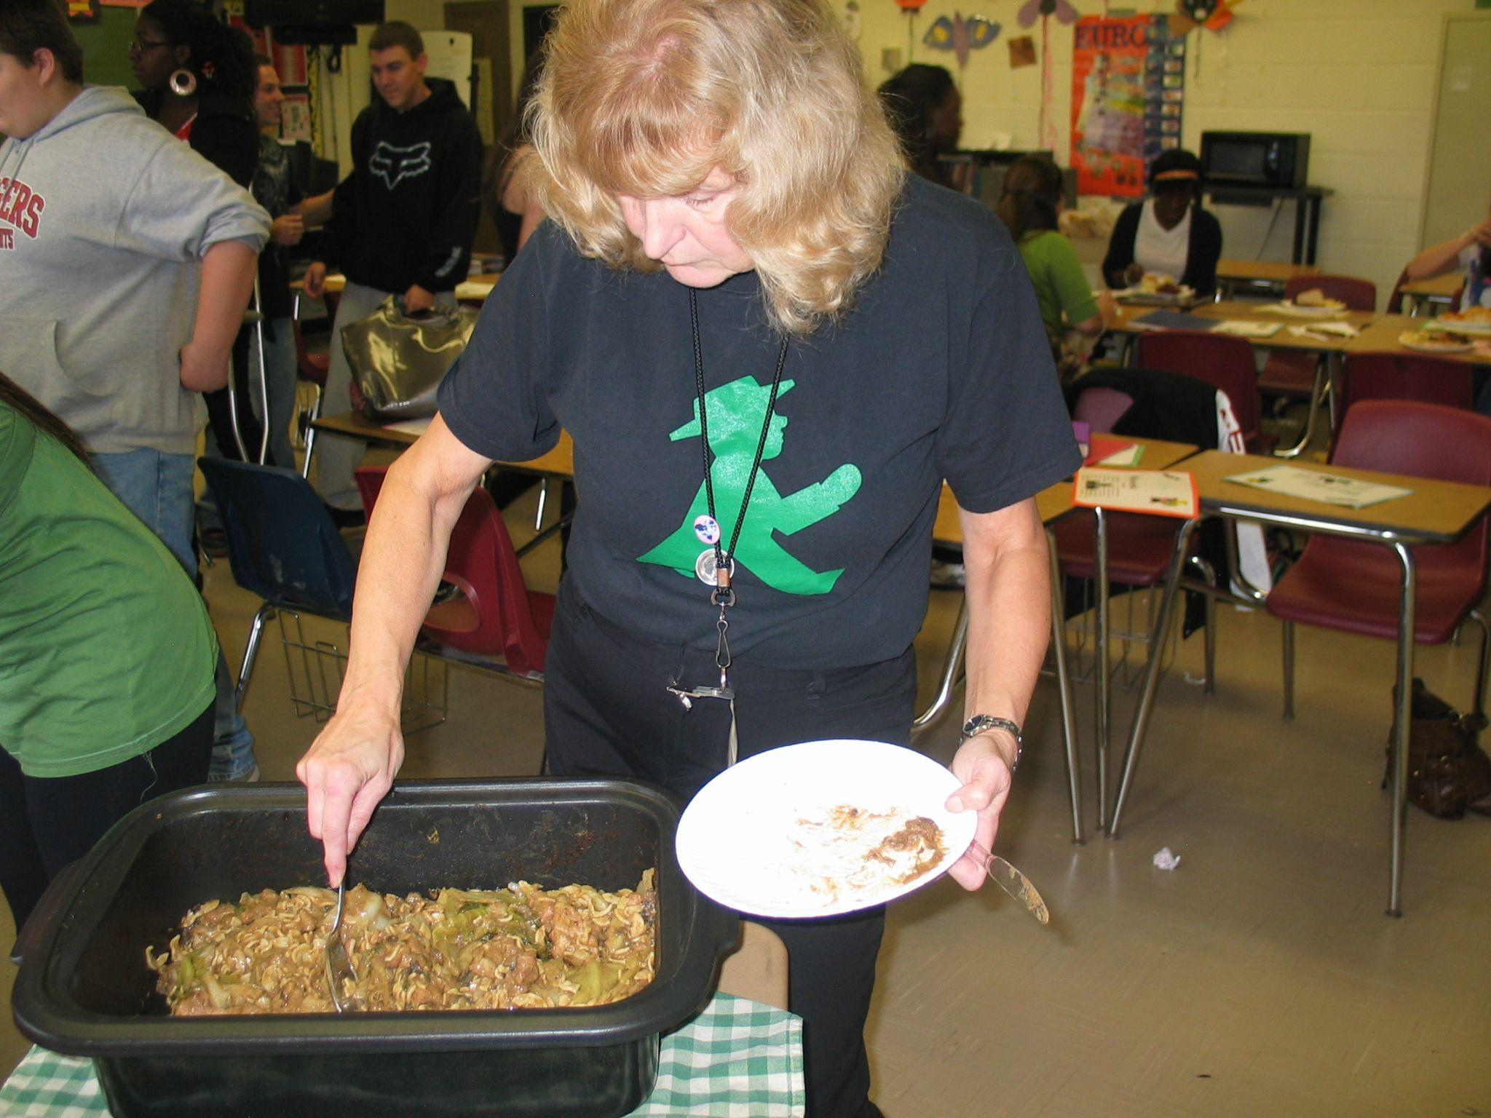
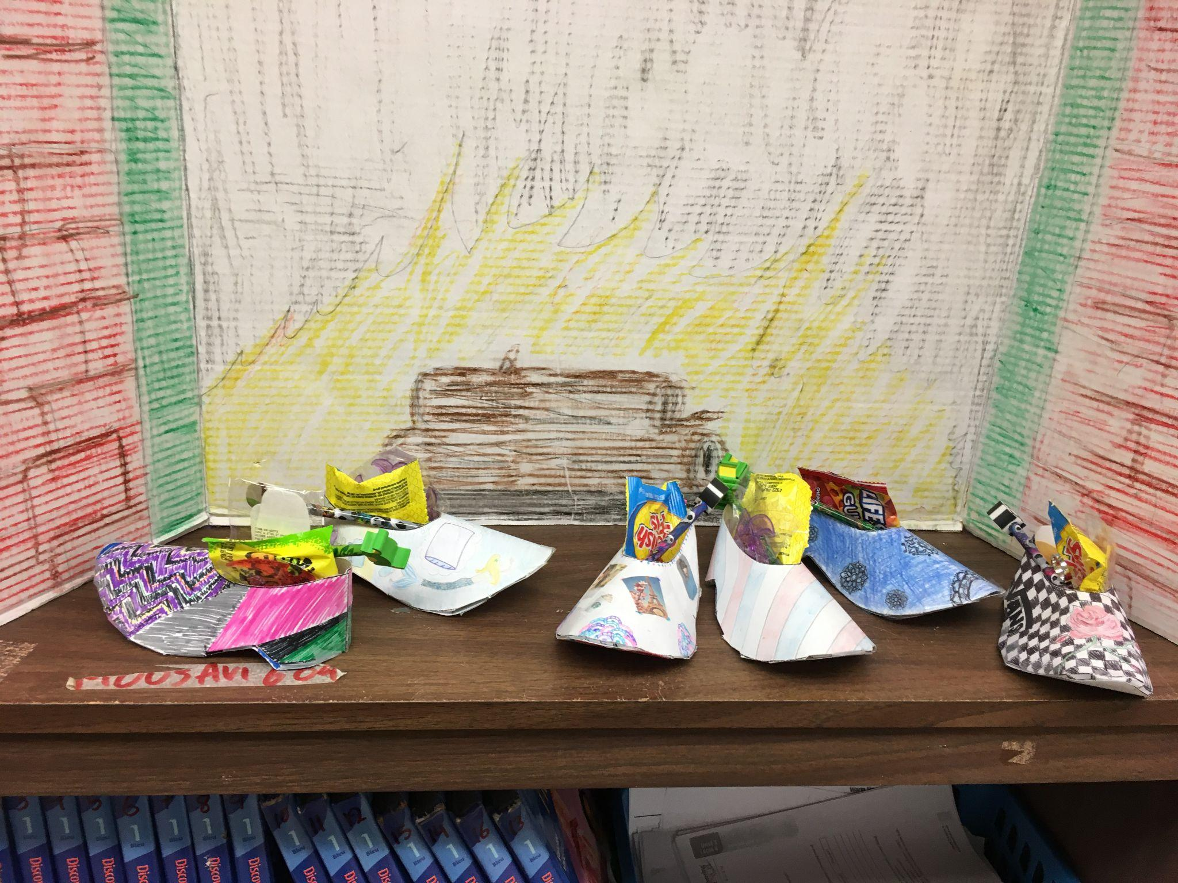
Madame Mousavi and I are the advisors for the World Cultures Club. We usually meet every other Wednesday. We explore different cultures; Oktoberfest, Chinese New Year, Mardi Gras and Cinco the Mayo to name a few…

Slide 9

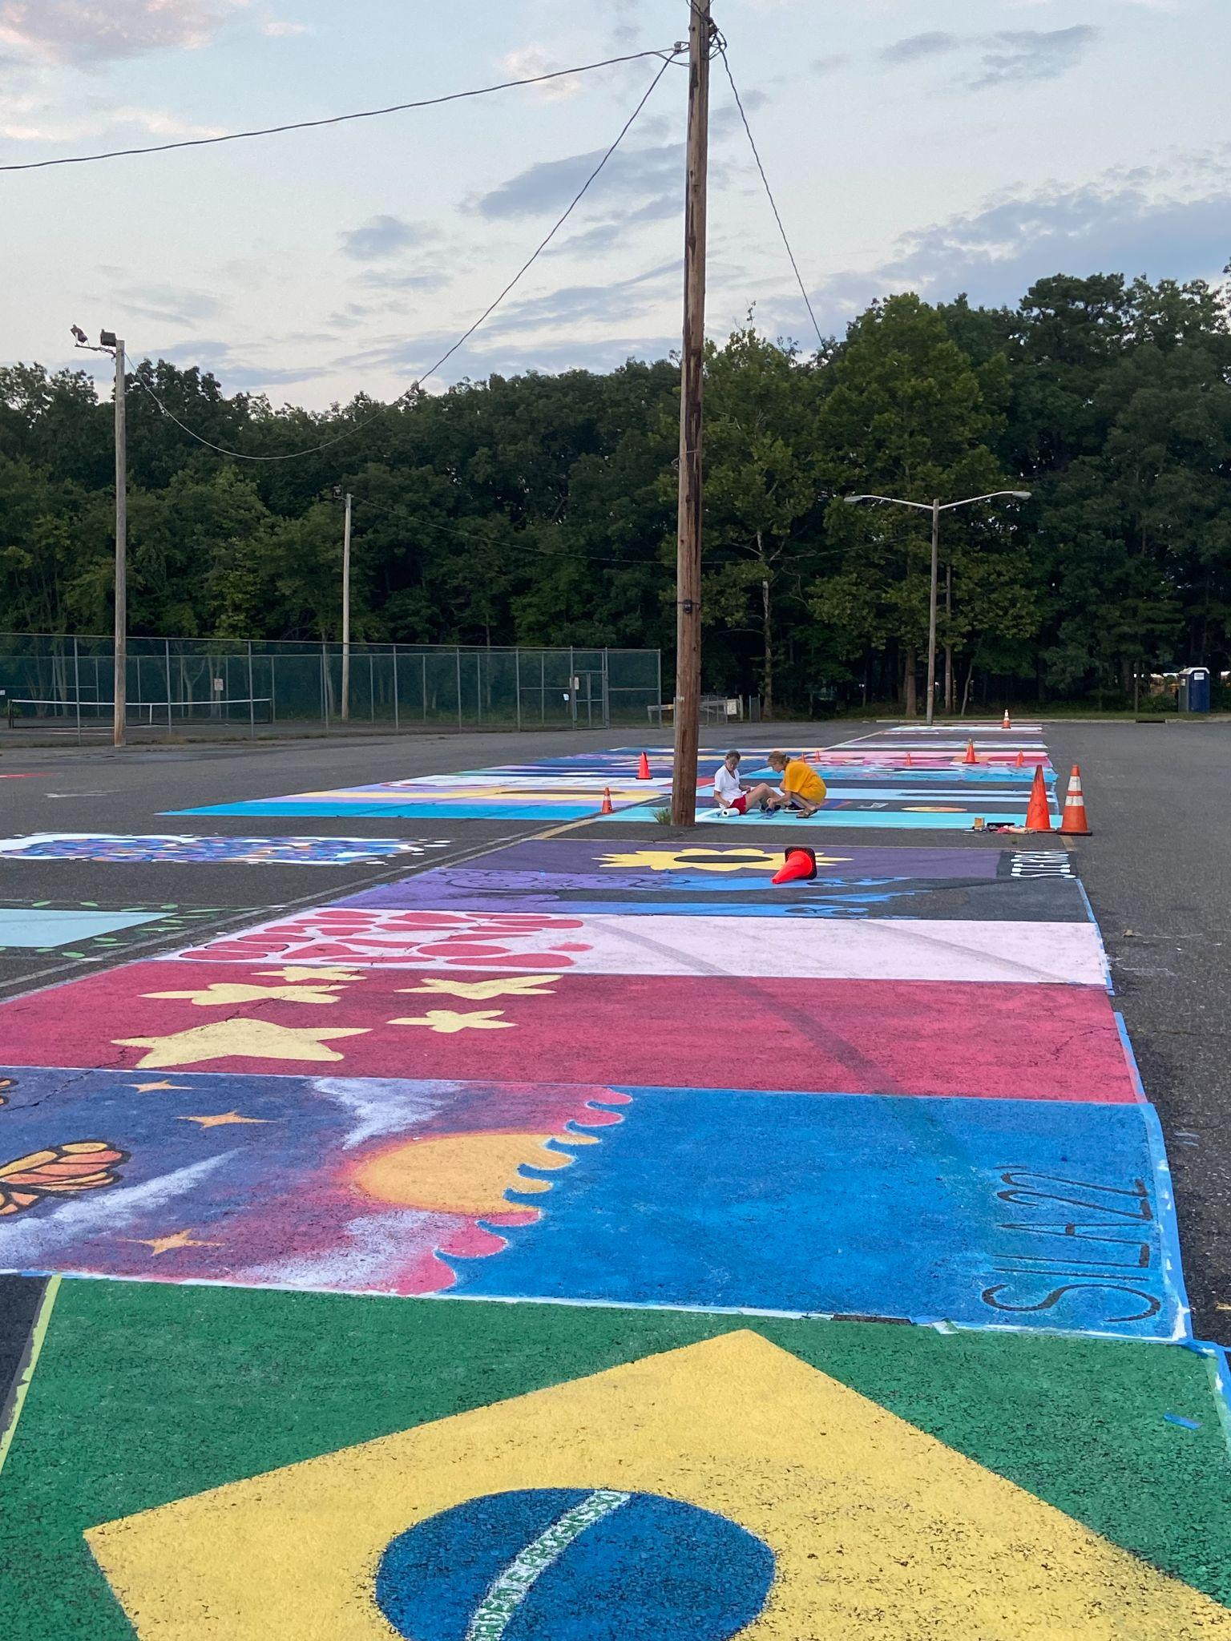
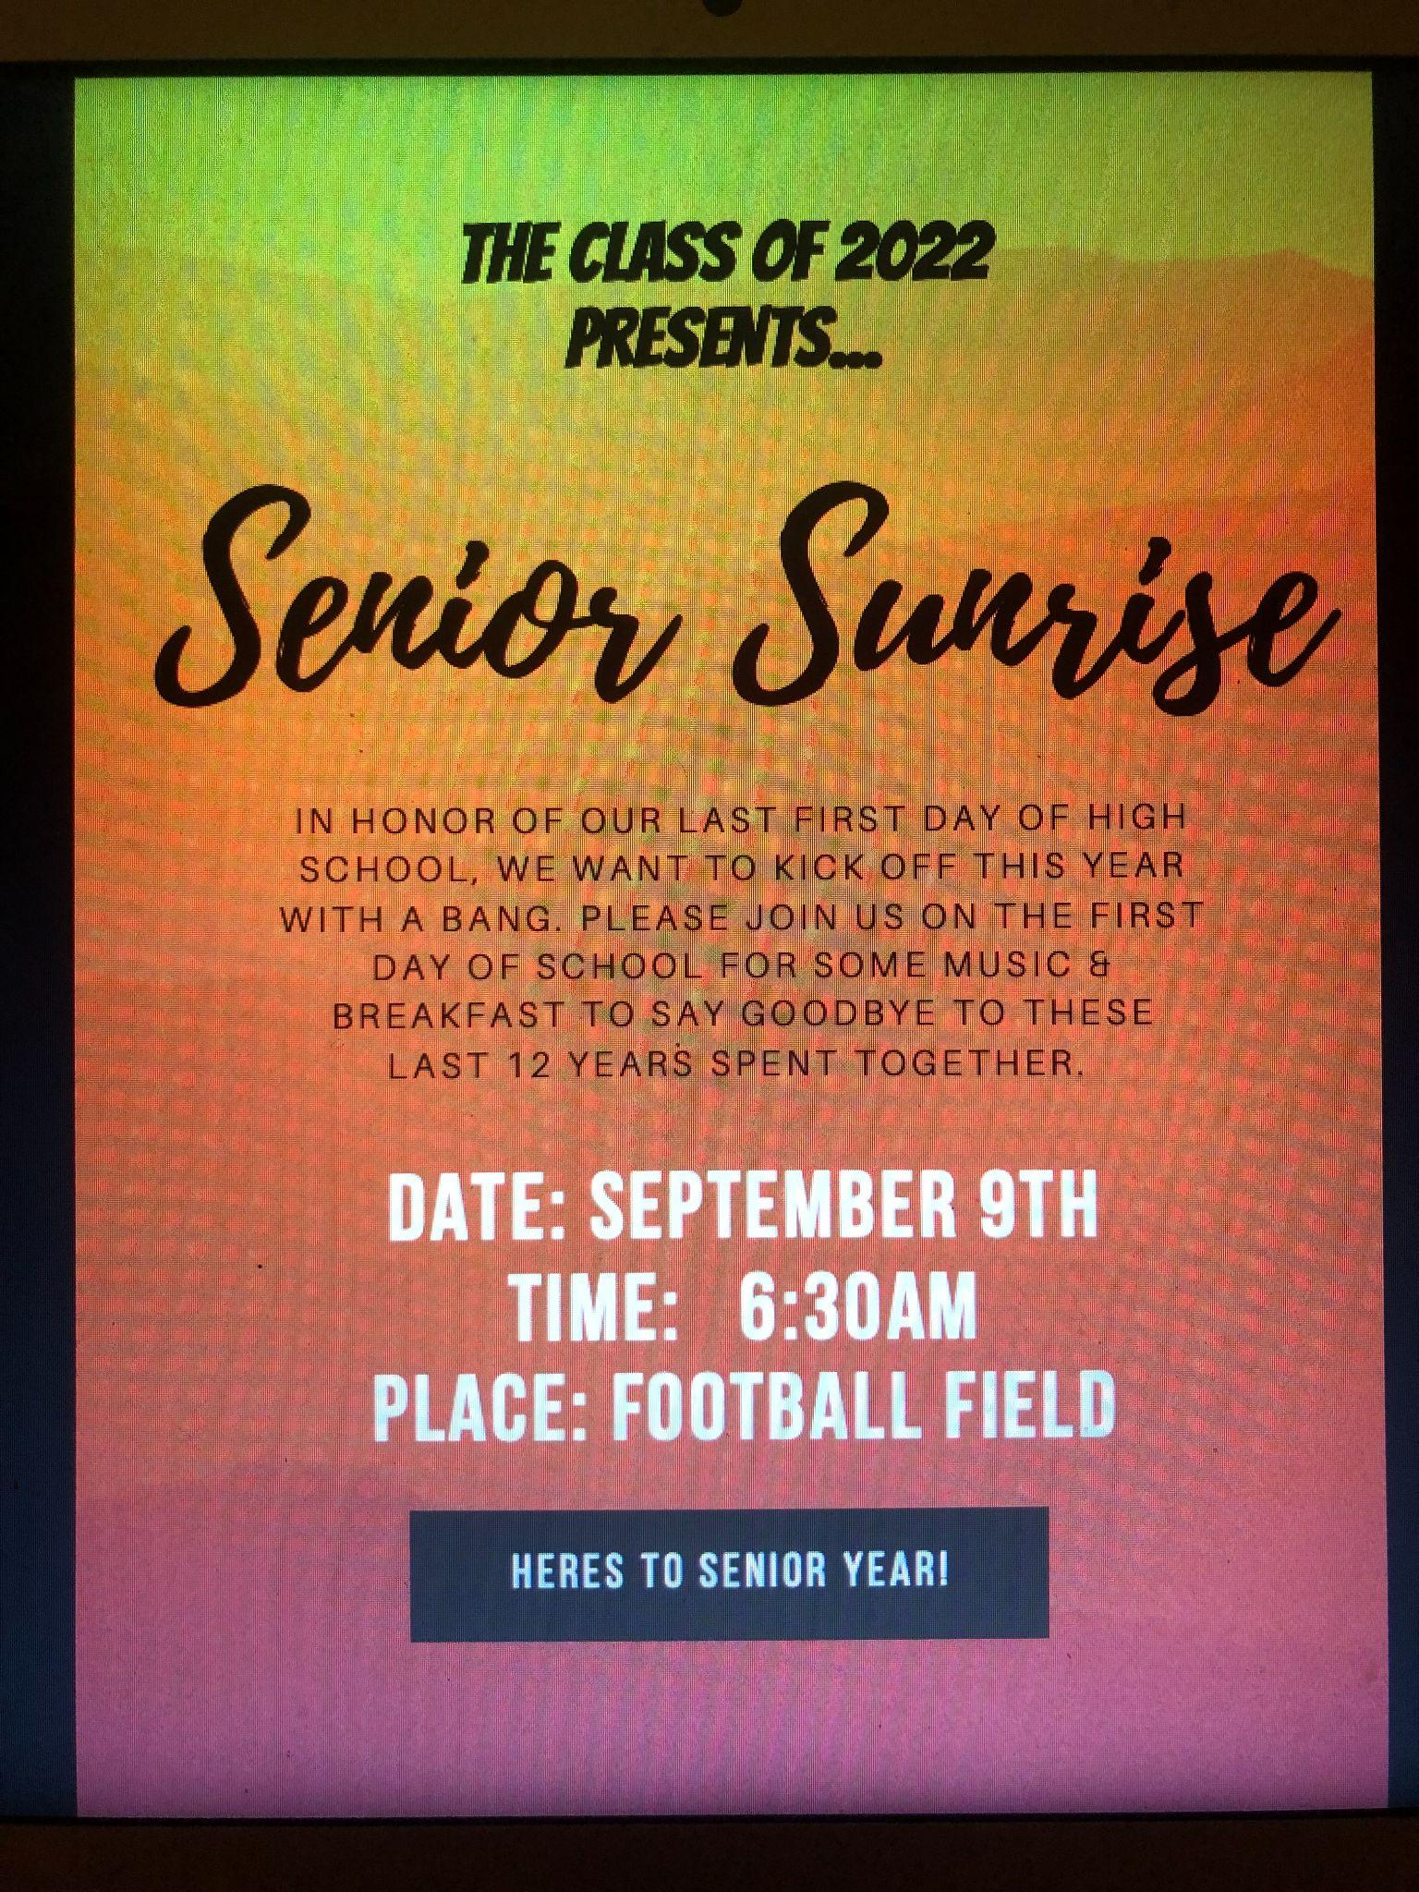
Madame Mousavi and I are also the class advisors for the for the class of 2022. We hope your students will get involved with student council.

Slide 10


Slide 11
GRACIAS
Thank you in advance for your anticipated support and cooperation in the months ahead.

